Slide 1


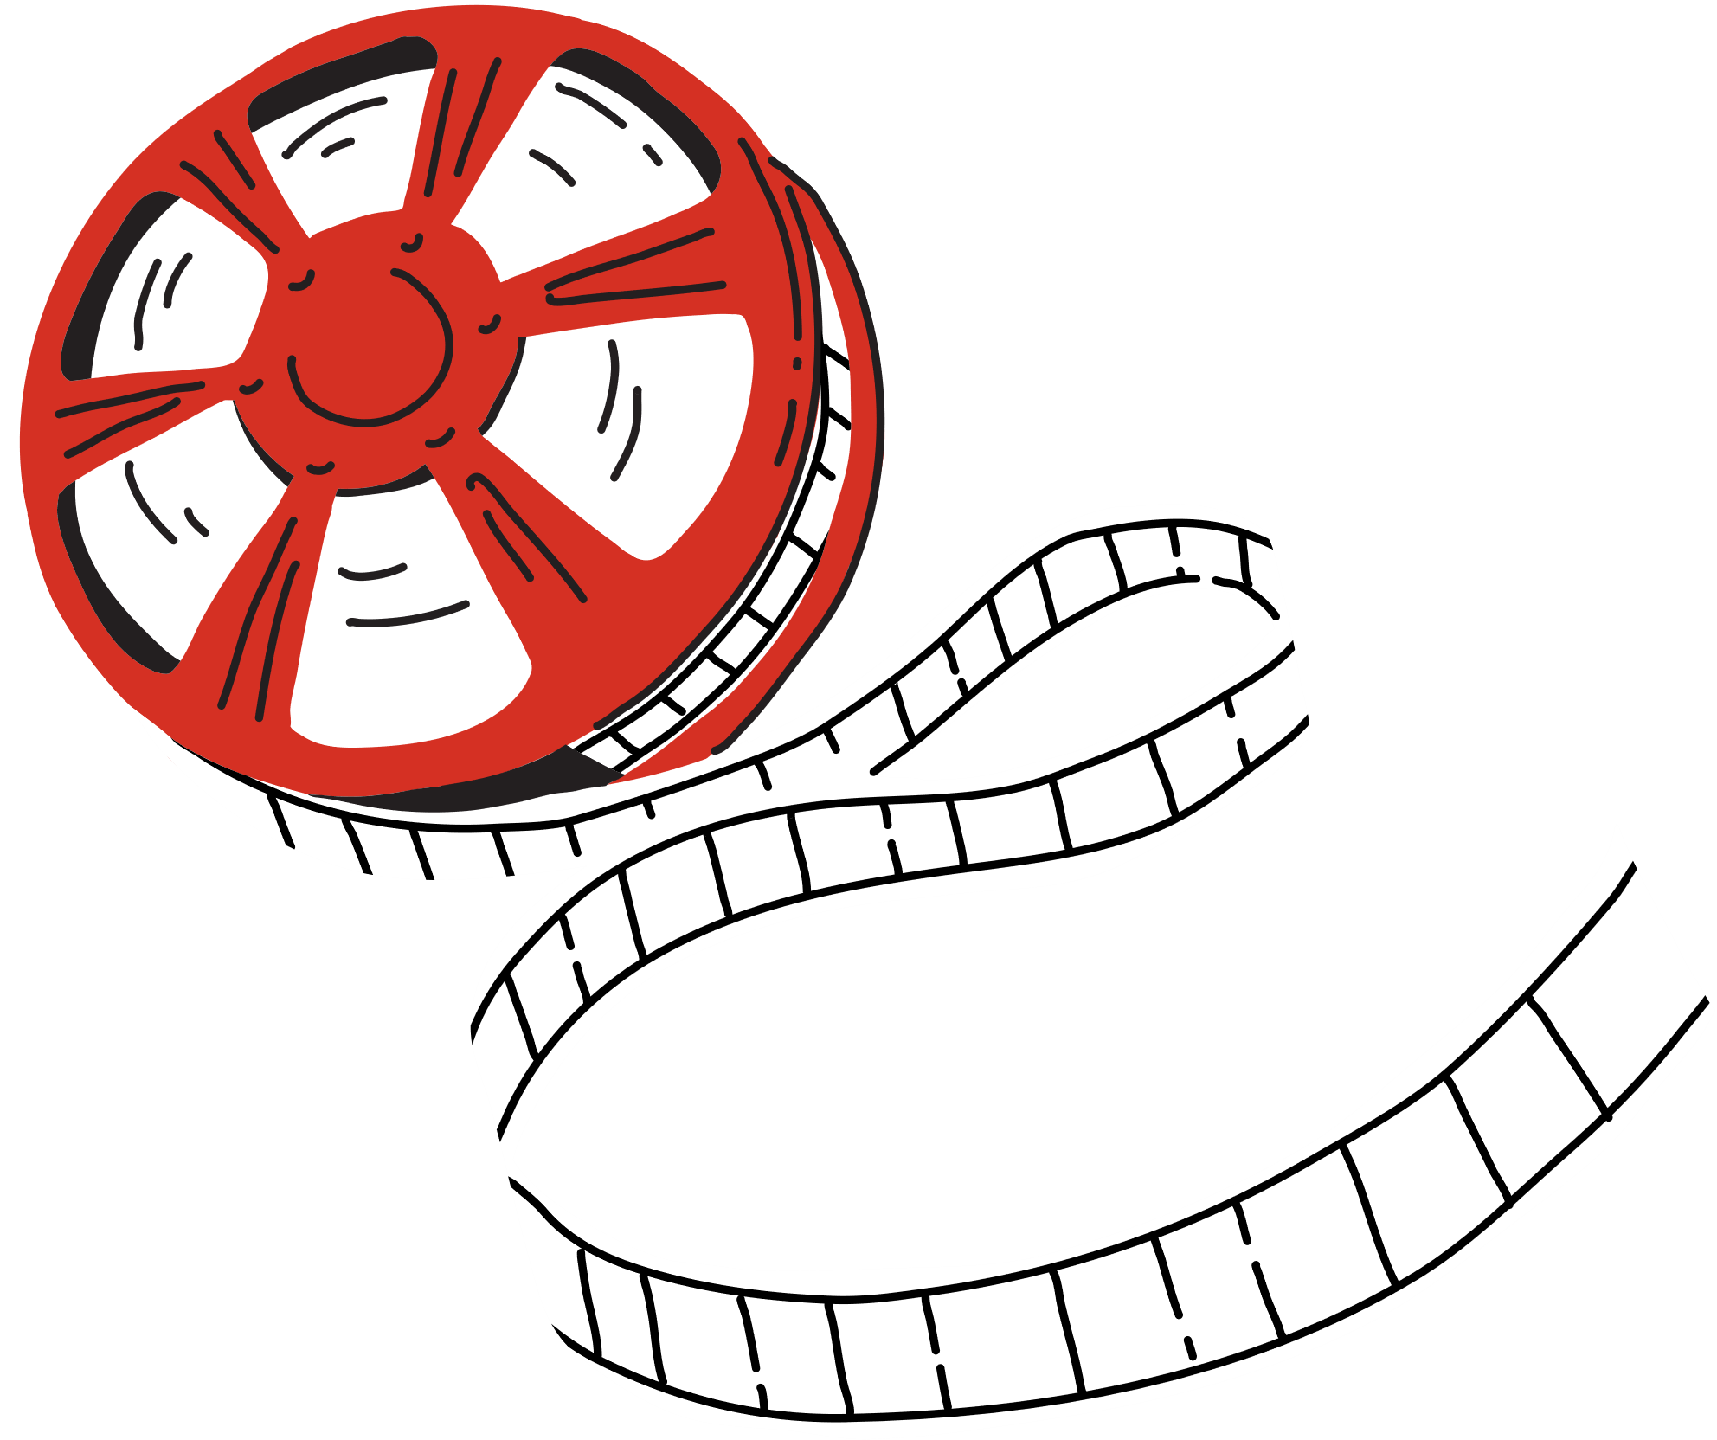




Movies Recommendation System
Project and Data Management Plan

Slide 2

Table Of Content
Research Question?
Aim and Objectives
Background
Data and Data Ethics
Project Plan
Data Management Plan

Slide 3


Research Question
Designing an Effective Movie Recommendation System Using MovieLens Dataset
Objective:
Predict user preferences and provide personalized movie suggestions.

Slide 4

Aim and Objectives
Aim:
Design and develop a personalized movie recommendation system using the MovieLens dataset.
Objectives:
Analyze the dataset to understand user preferences and trends.
Compare performance of three machine learning models:
Collaborative Filtering
Matrix Factorization
Content-Based Filtering
Evaluate models using metrics like RMSE, precision, and recall.

Slide 5
Aim and Objectives
4. Create visualizations (e.g., heatmaps, clustering) to explore user-movie interactions.
5. Develop a user-friendly interface to demonstrate the recommendation system.
3. Approach:
Begin with Exploratory Data Analysis (EDA).
Implement and compare the three models.
Optimize the best-performing model for deployment.
4.Flexibility:
Methods and analysis may evolve based on findings and challenges during the project.

Slide 6

Background
Importance:
Cornerstone of digital platforms (e.g., Netflix, Amazon Prime, Hulu).
Enhances user engagement and satisfaction through personalized content.
MovieLens Dataset:
Benchmark dataset for recommendation systems.
Includes user ratings, movie metadata, and tagging data.
Key Techniques:
Collaborative Filtering: Uses user-item interactions to identify patterns.
Matrix Factorization (e.g., SVD): Reduces dimensionality and uncovers latent factors.
Content-Based Filtering: Recommends items based on features like genre or director.
Project Focus:
Explore and compare these techniques using MovieLens dataset.
Build an effective and scalable movie recommendation system.

Slide 7

Data
Source:
Publicly available dataset maintained by GroupLens, University of Minnesota.
Content:
User-movie interactions: User IDs, movie IDs, ratings (1-5), and timestamps.
Movie metadata: Titles, genres, and release years.
Scale:
Commonly used version: 100,000 ratings, 1,000 users, 1,700 movies.
Suitability:
Ideal for training and evaluating recommendation algorithms.
Supports techniques like Collaborative Filtering, Matrix Factorization, and Content-Based Filtering.
Advantages:
Structured format and rich content.
Balances computational efficiency with sufficient data size.

Slide 8
Data Ethics
No Personally Identifiable Information (PII):
Dataset contains anonymized user IDs, ratings, and metadata.
Privacy Assurance:
No ethical concerns related to personal data usage or privacy.
Pre-Collected Data:
Publicly available for research; no additional anonymization required.
Project Focus:
Training and evaluating machine learning models (e.g., Collaborative Filtering, Matrix Factorization).
Testing Practices:
Standard methods like unit testing and cross-validation used.
No involvement of external human subjects.
Ethical Approval:
Not required as no new data is collected, and dataset is anonymized and publicly available.
Purpose:
Solely for academic research, ensuring minimal ethical concerns.

Slide 9
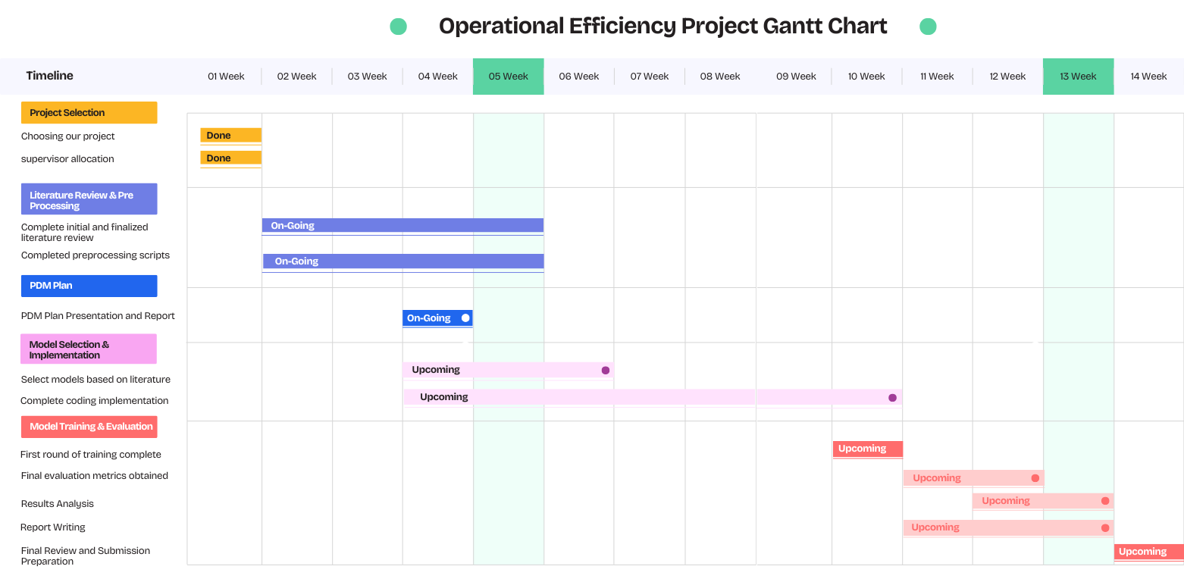
Project Plan

Slide 10


Data Management Plan
Data Collection:
MovieLens dataset sourced from GroupLens and stored locally in CSV format.
Backup Strategy:
Local backups: Weekly.
Cloud backups (e.g., Google Drive): Bi-weekly.
Version Control:
Managed via GitHub with weekly commits.
Repository Organization:
Structured folders for data, code, documentation, and results.
Goals:
Ensure secure storage, regular backups, and systematic version control.
Facilitate smooth and organized workflow throughout the project.

Slide 11
Thank You

